Slide 1
Oceanography
A Multiple Linear Regression of pCO2 against Sea Surface Temperature, Salinity, and Chlorophyll a at Station BATS and its Potential for Estimate pCO2 from Satellite Data
Lee Smalls, MyAsia Reid, Jinchun Yuan

Slide 2
Abstract
Ocean is one of the major reservoirs of carbon and can be a major sink of anthropogenic carbon dioxide. Together with pH, alkalinity, and total dissolved inorganic carbon (DIC), partial pressure of carbon dioxide (pCO₂) is one of the four essential parameters for determining aquatic CO₂ system. These four CO₂ parameters are interrelated through chemical equilibrium and the determination of any two is sufficient for calculating the other two parameters.( If you know two, you can calculate any other two). Ship-based oceanographic research cruise, that is expensive to operate and inefficient to provide global coverage, has long been the main source of data for characterizing oceanic CO₂ system.
Recently, Lohrenz and Cai (2006) conducted a field study of partial pressure of carbon dioxide, temperature, salinity, and Chlorophill a in surface waters of the Northern Gulf of Mexico and developed a correlation method for estimating carbon dioxide distribution from the Moderate Resolution Imaging Spectroradiometer (MODIS) remote sensing data. Although it showed great potential, the correlation is based on field data with a small temperature variation and atypical salinity, for open ocean waters, and it is not clear whether it can be applied elsewhere in the ocean. Here, we propose to extend the applicability of the method by conducting a data analysis study of field observations conducted at station BATS (Bermuda Atlantic Time-Series).
Specifically, we will: (1) Obtain field data of alkalinity, DIC, temperature, salinity, POC,DOC, andChlorophill a determined at BATS station in the last two decades; (2) Calculate pCO2 from alkalinity and DIC; (3) Apply the correlation method to test the applicability of the method in the central Atlantic Ocean

Slide 3
Methods
We used a program called CO2 System Macro. From two known C02 parameters:
TA-Total Aklinity
TCO2- Total Carbon Dioxide
They measured Total CO2 (Tco2)
and Alkalinity (Alk) at Bermuda.
The program will calculate :
pCO2 was calculated from Tco2 and Alkalnity.
They measured Total CO2 (Tco2) and Alkalinity (Alk) at Bermuda. pCO2 was calculated from Tco2 and Alk.

Slide 4
Methods:
How to run the CO2Sys Macro
In sheet INFO
You can select which section of the program you want information on by selecting the appropriate option from the top drop down list.
Single click the text box to make the vertical scroll bar appear and scroll down the text
In sheet INPUT
Select the set of CO2 constants
you want to use for the calculations
Select the KHSO4
Select the pH scale of your data

Slide 5
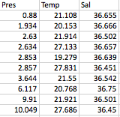
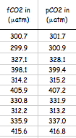
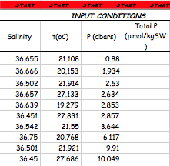
Methods
Inputting Data:
We input three sets of numbers from the Bermuda data.
The first set was the Pressure
The second set was the temperature.
The third set was Salinity.
This data was picked randomly after all the bad data was disgarded.

Slide 6
Linear Regression
What is a Linear Regression?
A process for determining the statistical relationship between a random variable and one or more independent variables that is used to predict the value of the random variable.

Slide 7
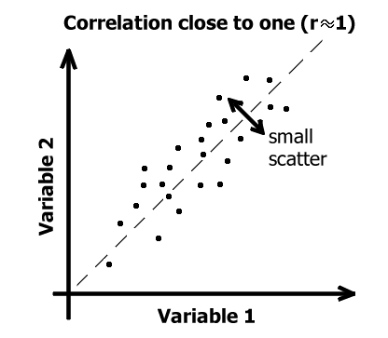
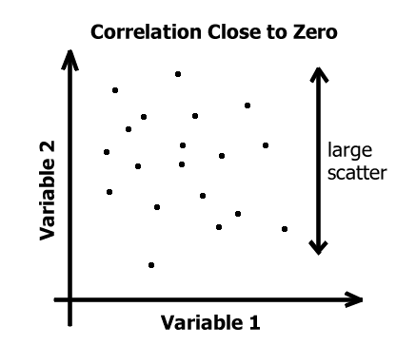
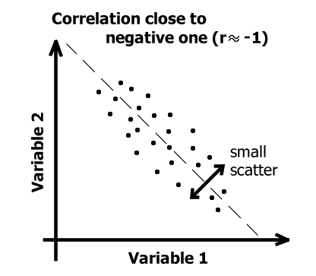
Linear Regression Graphs

Slide 8
Our Linear Regression
pCO₂-Temperature, Salinity, and Chlorophyll a
pCO₂- Temperature, Salinity, and Dissolved Organic Carbon (DOC)
pCO₂- Temperature, Salinity, and Particular Carbon (PC)
The Analysis Tool Pak was used to calculate the regression,
by dragging the numbers from the cell into the Y and X Input ranges,
Then clicking on an empty cell to show the output values.

Slide 9
P-Value
What is P-Value?
P is short for probability: the probability of getting something more extreme than your results; a number is 0.
In order to say whether your results are statistically significant, you have to generate a p value from a test statistic. You then indicate a significant result with "p<0.05". So let's find out what this p is, what's special about 0.05, and when to use p.
First you assume there is no effect in the data. Then you see if the value you get for the effect in your sample is the sort of value you would expect for no effect in the data. If the value you get is unlikely for no effect, you conclude there is an effect, and you say the result is "statistically significant".

Slide 10
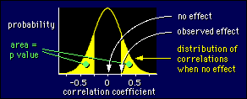
P-Value
The closer the regression is to 1, the better.
The closer the P-value is to 0, the better.
If the P-Value is more than .05, eliminate, because it isn’t very good.

Slide 11
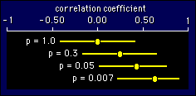
P-Value
A p value of less than 0.05 is the same as having a 95% confidence interval that doesn't overlap zero.
This figure shows some examples of the relationship between p-values
If your observed effect is positive, then half of the p value is the probability that the true effect is negative.

Slide 12
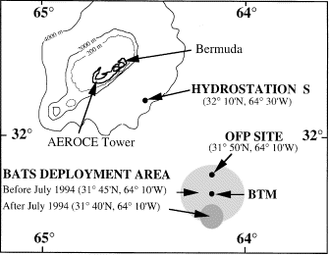
Station BATs
The Bermuda Atlantic Time-series Study (BATS) is a long-term oceanographic study by the Bermuda Institute of Ocean Sciences (BIOS). Based on regular (monthly or better) research cruises, it samples an area of the western Atlantic Ocean.

Slide 13
Results
R-Square | Coefficients | P-Value
Intercept | 575.26 | 0.62
Temperature (x1) | 12.47 | 1.01
Salinity (x2) | -14.32 | 0.64
Particular Organic Carbon | 0.00 | 0.98
Chlorophyll a | 33.19 | 0.017

Slide 14
Results
R-Square | Coefficients | P-Value
Intercept | -2024.95 | 0.33
Temperature (x1) | 14.53 | 2.91
Salinity (x2) | 55.30 | 0.32
Dissolved Organic Carbon | 0.12 | 0.95
Chlorophyll a | 45.13 | 0.49

Slide 15
Results
Our Methods
From the Bermuda data collected, we used field data of Temperature, Salinity, TAlk, Dissolved Organic Carbon (DOC), Chlorophyll a, and Particular Organic Carbon (POC) collected from BATs Station (Figure 1). All of the non useful data measurements (i.e.
negative numbers) were removed. The remaining data were put into the data analysis software in Microsoft Excel. That information was then used to calculate the regression. The results of the regression analysis allowed us to compare original pCO2 data and pCO2 predicted to calculate the multiple linear regression equation.

Slide 16
References
http://ijgofs.whoi.edu/Time-Series/LTTS.html

